Slide 1
Radar Perception for Gesture Recognition
Josiah W. Smith
Advisor: Dr. Murat Torlak
Special thanks to: Shiva Thiagarajan, Richard Willis, Bhaskar Upadhyay, Dr. Muhammet Yanik

Slide 2
Outline
Static Hand Gesture Recognition
Setup and data format
Preprocessing techniques
Results
Dynamic Hand Gesture Recognition
Setup and data format
Preprocessing techniques and cost efficiency analysis
Interfacing with Terahertz Sensor IC
Submillimeter relative range estimation
Conclusions and Future Work

Slide 3
Static Hand Gesture Recognition

Slide 4
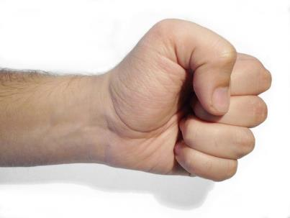
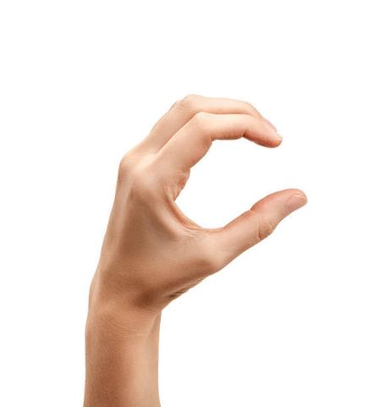




Static Hand Gestures
Fist
C
Palm
Perpendicular (perp)
Thumbs Up (tu)
Two

Slide 5
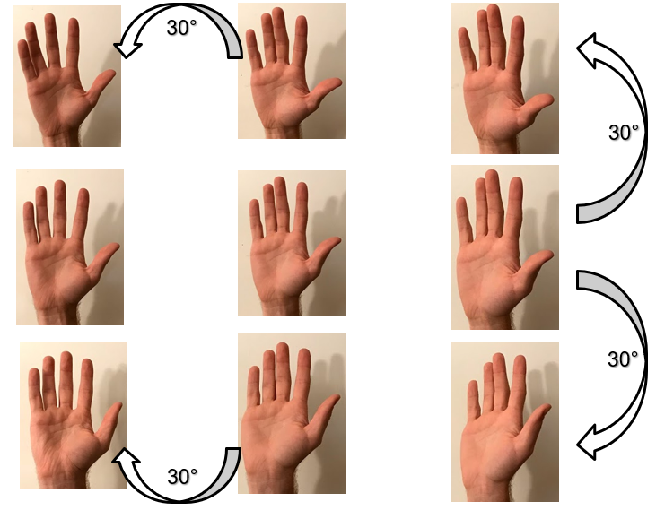
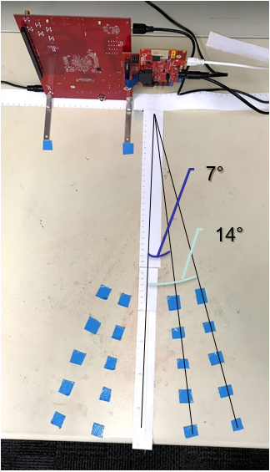
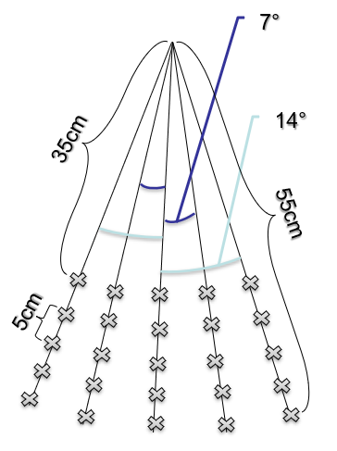
Setup and Degrees of Freedom
As shown below, capture FOV ranges from 35-55cm across a FOV of 28°, at increments of 5cm.

Slide 6
Static Data Format
At each location, one capture is made per hand orientation
Each capture consists of 64 frames, only the first fame is used
100 captures = 4 different hand orientations at each of the 25 locations
Radar Parameters:
3 TX, 4 RX (12 Virtual MIMO Channels)
16bit, Complex1x
Start Frequency: 77GHz
Bandwidth: 3.99948GHz
R_{max} = 3m
Slope: 99.987 Hz/s
Sample Rate: 2000 ksps

Slide 7
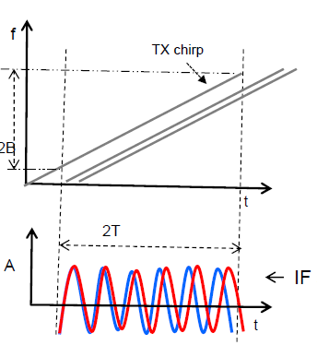
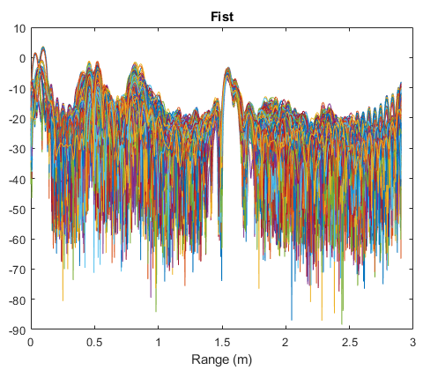
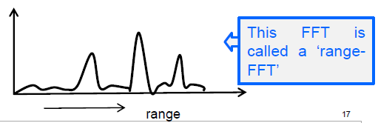
Range FFT of Received Signal
Multiple reflections result in multiple peaks in the range domain [1].
For gesture case, many peaks and noise can be seen in the range spectrum.

Slide 8
Static Datasets
Dataset 1: 2000/class
Same location at radar bore side
Single subject, across several weeks
83% Accuracy
Dataset 2: 4000/class
Ranges 35cm-55cm and 28° FOV
3 subjects, hand too close to torso
61% Accuracy
Dataset 3: 405/class
Ranges 45cm-55cm and 14° FOV
Hand held away from torso
86% Accuracy

Slide 9
Range FFT Format
R1 | R2
RN
...
Channel 1
Channel 2
Channel 3
Channel 4
Channel 5
Channel 6
Channel 7
Channel 8
Channel 9
Channel 10
Channel 11
Channel 12
Range FFT produces a 12 x N array with 12 virtual channels and N range bins
...
...

Slide 10
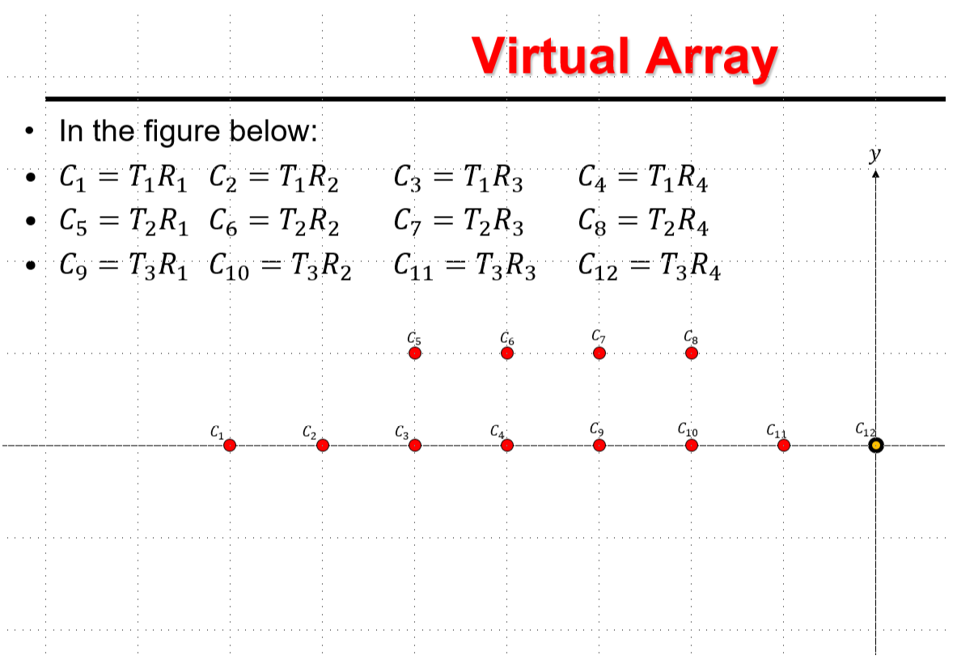
Reformatting Range FFT to 3D
R1 | R2
RN
Reformatted Range FFT to align with virtual array produces array of size 8 x N x 2
Channel 1
Channel 2
Channel 3
Channel 4
Channel 9
Channel 10
Channel 11
Channel 12
Zero Pad
Zero Pad
Channel 5
Channel 6
Channel 7
Channel 8
Zero Pad
Zero Pad
...
...
Notes:
Make slide about real/complex layering of machine learning network

Slide 11
3D Range-Angle FFT
R1 | R2
RN
After Range-FFT, another FFT is performed across the sensor dimension to produce the Range-Angle FFT.
The angle domain shows a peak at the azimuth angle of arrival for returning chirp signals.
We will consider a region of the Angle-Range FFT in which we expect the gesture to appear.
Dimension 1
...
Dimension 2
...

Slide 12
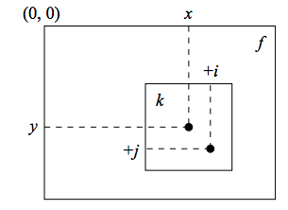
Preprocessing Techniques
Data formatting
Layer real and imaginary parts
Leverage relative phase differences between channels by maintaining matrix format rather than vectorizing data
Drastic accuracy increase
Null Torso Peak
Attempt to remove torso peak and sidelobes
Some accuracy reduction, revisit
Range-Channel Autocorrelation
2D correlate to create spatial invariance
No change in accuracies, revisit

Slide 13
Preprocessing Results
Range-Angle FFT
Reformat data with prior knowledge of virtual array structure
Exploit both elevation and azimuth information
Increase in accuracy
 | Dataset 1 | Dataset 2 | Dataset 3
Raw | 83% | - | -
Reformatted | 95% | 61% | 86%
Nulled | - | 61% | 80%
Autocorr | 95% | 62% | 87%
Range-Angle FFT | 99% | 75% | 91%

Slide 14
Dynamic Hand Gesture Recognition

Slide 15
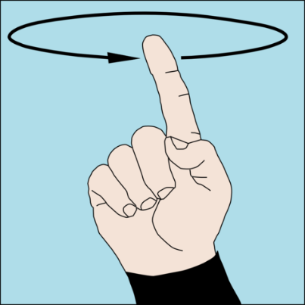
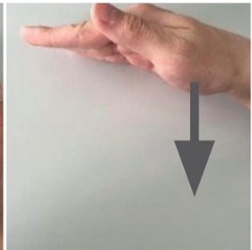
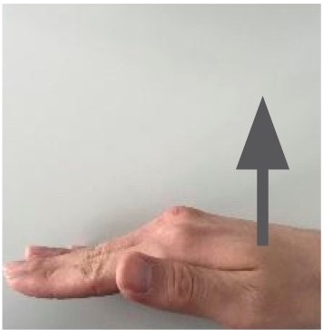
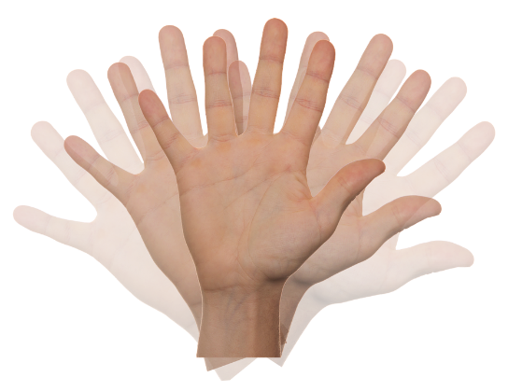
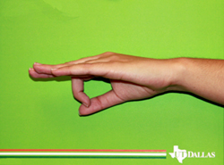
Dynamic Hand Gestures
Circle
Push
Pull
Wave
Whoosh

Slide 16
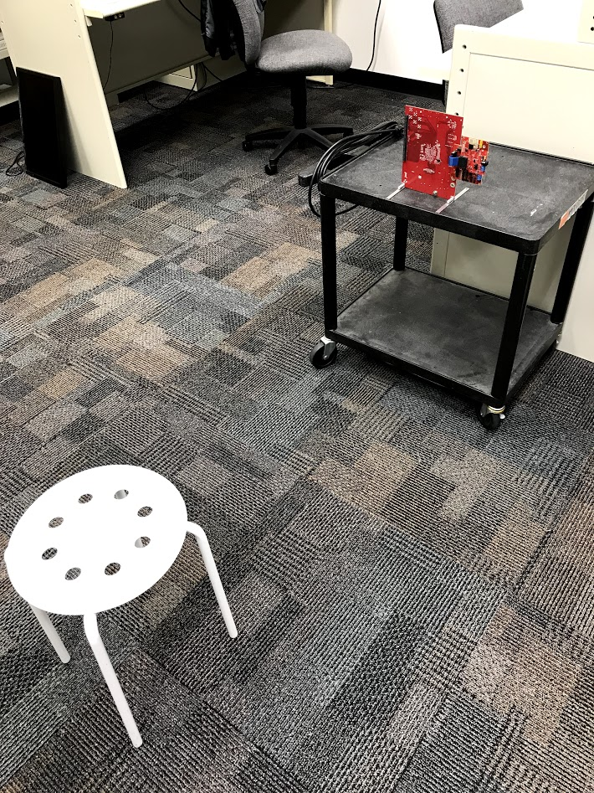
Dynamic Data Collection Setup
Chest high radar
~1m from sitting user
Simple range FFT computed for each capture
Radar Parameters:
3 TX, 4 RX (12 Virtual MIMO Channels)
16bit, Complex1x
Start Frequency: 77GHz
Bandwidth: 3.99948GHz
R_{max} = 3m
Slope: 99.987 Hz/s
Sample Rate: 2000 ksps
64 Fast Time Samples

Slide 17
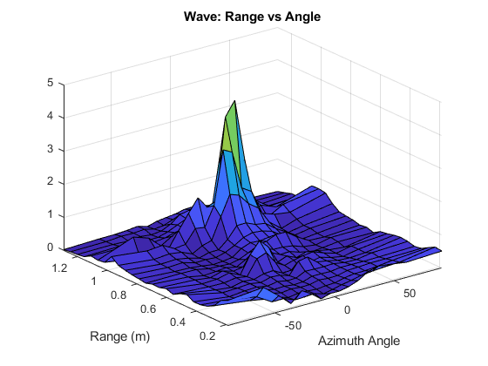
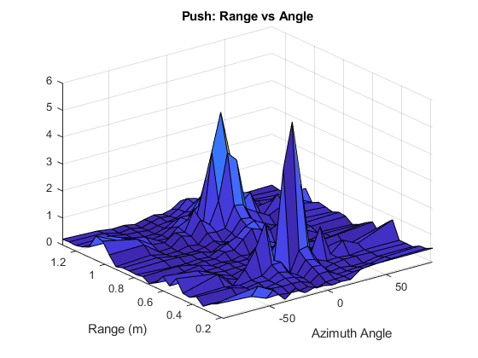
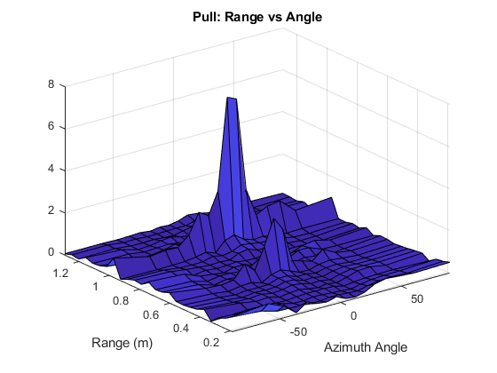
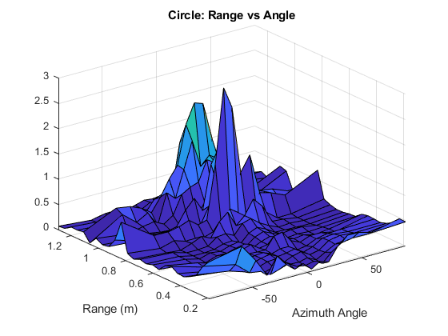
Preprocessing Techniques: Angle FFT
Channel to azimuth angle domain
Considering geometry of aperture, FFT across channel domain produces angular domain
16 Angle Bins
Filter angular domain to effectively achieve RX beamforming

Slide 18
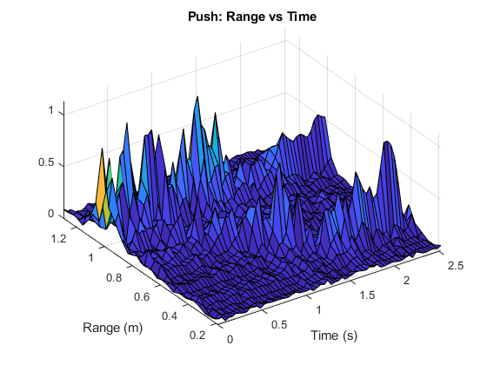
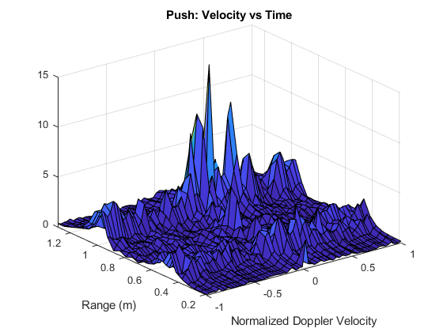
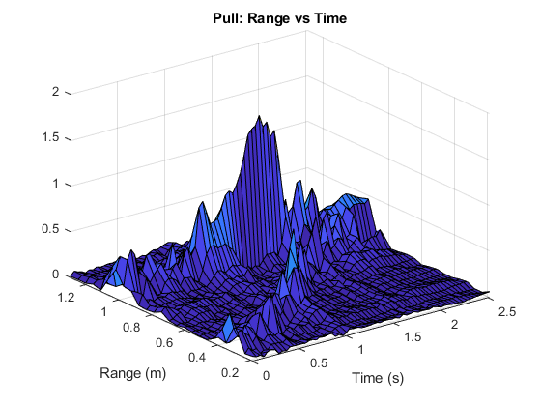
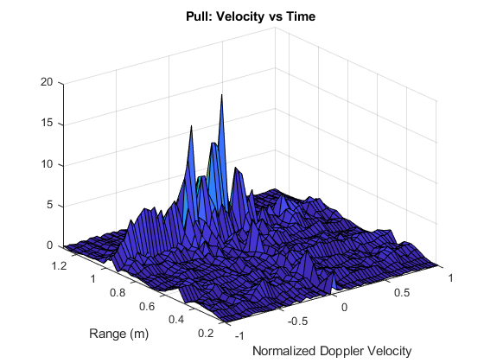
Preprocessing Techniques: Doppler (Velocity) FFT
Positive
Velocity
Negative
Velocity

Slide 19
Preprocessing Techniques: STFT

Slide 20
Dynamic Dataset: Results and Size
Dataset 4 – 600/class
512 frames over 2.56s (5ms PRI)
Captured across different days, same subject
Size of data for each class (64, 12, 512, 600)
64: range bins (25 bins containing torso and hand)
12: virtual antennas
512: slow-time (frame index)
600: captures/class

Slide 21
3-Tx, 4-Rx Channels Used
Preprocessing Technique
Range FFT
Range, Doppler
Range, Doppler Filtered
Range, Angle
Range, Angle, Doppler Filtered
Range FFT, Doppler STFT Filtered
Range, Angle, Doppler STFT Filtered
Data Size / Class
(25, 12, 512, 600)
(25, 12, 512, 600)
(25, 12, 64, 600)
(25, 16, 512, 600)
(25, 16, 64, 600)
(25, 12, 13, 64, 600)
(25, 16, 13, 64, 600)
Efficiency
98.8% / 28ms
99.2% / 29ms
98.2% / 15ms
99% / 16ms
99.2% / 19ms
97.5% / 25ms
98.8% / 28ms

Slide 22
First Channel Only (More Efficient)
Preprocessing Technique
Range FFT
Range, Doppler
Range, Doppler Filtered
Range FFT, Doppler STFT Filtered
Range FFT 40ms PRI (subsampled)
Range, Doppler 40ms PRI
Data Size / Class
(25, 1, 512, 600)
(25, 1, 512, 600)
(25, 1, 64, 600)
(25, 1, 13, 64, 600)
(25, 1, 64, 600)
(25, 1, 64, 600)
Efficiency
98.5% / 9ms
99.5% / 10ms
98.8% / 8.5ms
99.3% / 9ms
98.5% / 9ms
98.5% / 9.2ms

Slide 23
Subsample from 5ms PRI to 40ms PRI
Preprocessing Technique
Range FFT 40ms PRI (subsampled)
Range, Doppler 40ms PRI
Range, Angle 40ms PRI
Range, Angle, Doppler 40ms PRI
Data Size / Class
(25, 12, 64, 600)
(25, 12, 64, 600)
(25, 16, 64, 600)
(25, 16, 64, 600)
Efficiency
96.2% / 12ms
98.8% / 12.2ms
98.8% / 13ms
99.7% / 13ms
Computational time = preprocessing time + classification time
Conclusions:
Range & doppler analysis yields the most efficient classification

Slide 24
Range Doppler
Range FFT
Range, Angle, Doppler, 40ms
Range FFT 40ms
Range Doppler 1 Channel
Range Doppler Filtered 1 Channel
Range FFT 1 Channel 40ms

Slide 25
Dynamic Gesture Classification Results
 | Preprocessing Technique | Data Size / Class | Accuracy | Computation Time | Efficiency Score
3-Tx / 4-Rx | Range FFT | (25, 12, 512, 600) | 98.8% | 28 ms | 10.95
 | Range-Doppler FFT | (25, 12, 512, 600) | 99.2% | 28 ms | 10.99
 | Range-Doppler FFT Filtered | (25, 12, 64, 600) | 98.2% | 12 ms | 18.26
 | Range-Angle FFT | (25, 16, 512, 600) | 99% | 32 ms | 9.81
 | Range-Angle-Doppler FFT Filtered | (25, 16, 64, 600) | 99.2% | 19 ms | 14.36
 | Range-Doppler STFT Filtered | (25, 12, 13, 64, 600) | 97.5% | 35 ms | 8.90
 | Range-Angle-Doppler STFT Filtered | (25, 16, 13, 64, 600) | 98.8% | 38 ms | 8.30
 | Range FFT (8x downsampled) | (25, 12, 64, 600) | 96.2% | 12 ms | 18.08
 | Range-Doppler FFT (8x downsampled) | (25, 12, 64, 600) | 98.8% | 12 ms | 18.31
 | Range-Angle FFT (8x downsampled) | (25, 16, 64, 600) | 98.8% | 13 ms | 17.62
 | Range-Angle-Doppler FFT (8x downsampled) | (25, 16, 64, 600) | 99.7% | 13 ms | 17.70
1-Tx / 1-Rx | Range FFT (1 channel) | (25, 512, 600) | 98.5% | 9 ms | 20.78
 | Range-Doppler FFT (1 channel) | (25, 512, 600) | 99.5% | 10 ms | 19.96
 | Range-Doppler FFT Filtered (1 channel) | (25, 64, 600) | 99.5% | 8.5 ms | 21.37
 | Range-Doppler STFT Filtered (1 channel) | (25, 13, 64, 600) | 99.3% | 9 ms | 20.85
 | Range FFT (1 channel, 8x downsampled) | (25, 64, 600) | 98.5% | 8.5 ms | 21.28
 | Range-Doppler (1 channel, 8x downsampled) | (25, 64, 600) | 98.5% | 8.5 ms | 21.28

Slide 26
Interfacing with Terahertz Sensor IC

Slide 27

Motion Detection via Phase Extraction
Using THz IC, temporary setup constructed to extract relative range information from phase of IF signal by:
Single peak at 50kHz
$$\hat{R}=−\frac{φ}{2πf_{TX}}c$$
USRP-SDR
Software
273.6GHz
480MHz
250kHz
50kHz
RF-TX
RF-RX
IF
D-IF
MD-IF
LPF
100kHz
479.75GHz
200kHz
Signal Generator
Signal Generator
Phase
Phase Extractor

Slide 28
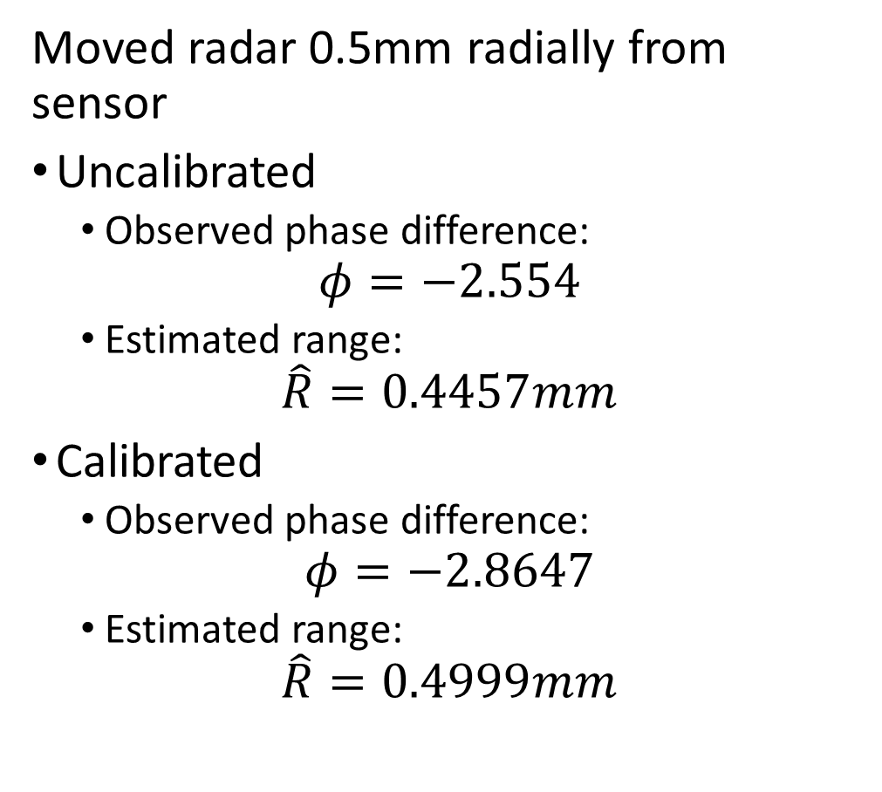
Submillimeter Relative Range Estimation
Moved radar 0.5mm radially from sensor
Uncalibrated
Observed phase difference:
$$φ=−2.554$$
Estimated range:
$$\hat{R}=0.4457mm$$
Calibrated
Observed phase difference:
$$φ=−2.8647$$
Estimated range:
$$\hat{R}=0.4999mm$$

Slide 29
Conclusions and Future Work
Using scanner to capture multiple perspectives increases static pattern classification rate substantially
Determine more THz sensing problems to investigate
Ongoing and Future Work
New applications for item detection
Continued synergy among TxACE groups to obtain THz IC
Contacted this week requesting update
Use mechanical scanner for scenario simulation
Cascaded TI EVM Radar

Slide 30


Questions?

Slide 31
References
[1] S. Rao, "Introduction to mmwave Sensing: FMCW Radars", Texas Instruments.

Slide 32
Backup Slides

Slide 33
Dynamic Transition Gestures

Slide 34
Dynamic Transition Gestures
Fist
C
Fist
Palm
Fist
Perpendicular (perp)
Fist
Two
Gesture 30-50cm from radar
Torso kept away from gesture
Captures all taken consecutively
50 captures/gesture
Fist
Thumbs Up (tu)

Slide 35
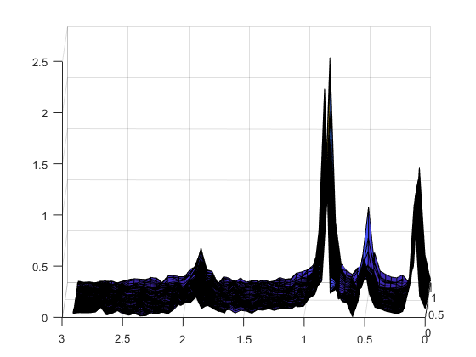
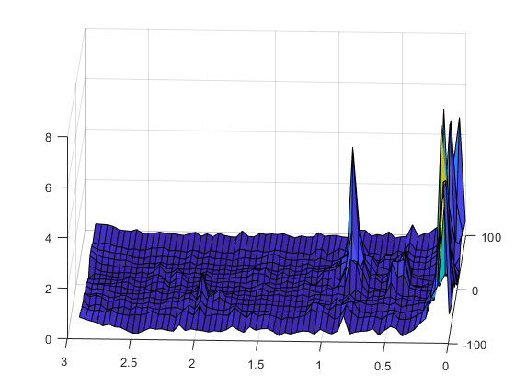
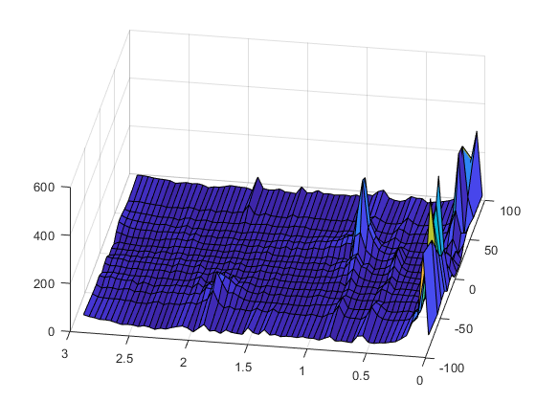
Dynamic Transition Results
2 Datasets
Fast (5ms PRI)
Slow (15ms PRI)
Preprocessing
Range Angle
Range Doppler
Range, Angle, and Doppler
 | Slow Dataset | Fast Dataset
Range | 58% | 74%
Range Angle | 66% | 74%
Range Doppler | 72% | 78%
RAD | 72% | 86%
Fist-Tu Range vs Time
Fist-Tu Range vs Angle
Fist-C Angle vs Velocity
Conclusion: Need to leverage doppler information better

Slide 36
Appendix of Terms
FOV: Field of View
MIMO: Multiple Input Multiple Output
FFT: Fast Fourier Transform
TDM: Time Division Multiplexing
PRI: Pulse Repetition Interval

Slide 37
Fast SAR Imaging for Static Gestures

Slide 38
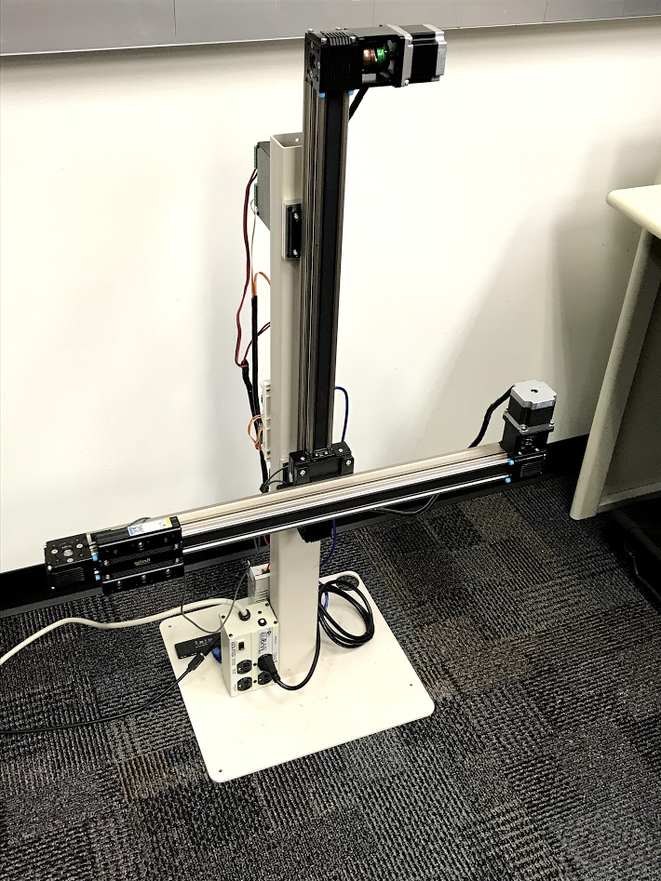
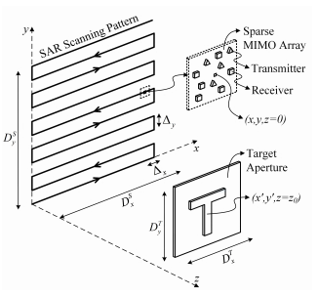
Mechanical Imaging Scanner
2D linear mechanical scanning allows for high resolution synthetic aperture imaging

Slide 39
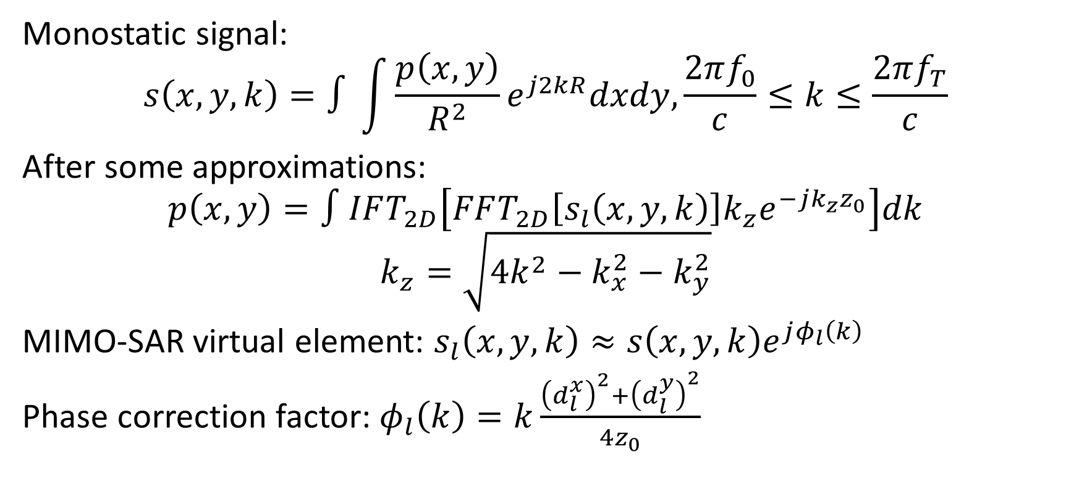
MIMO Signal Model
Monostatic signal:
$$s\left(x,y,k\right)=∫\int{\frac{p\left(x,y\right)}{R^{2}}}e^{j2kR}dxdy,\frac{2πf_{0}}{c}≤k≤\frac{2πf_{T}}{c}$$
After some approximations:
$$p\left(x,y\right)=∫IFT_{2D}\left[FFT_{2D}\left[s_{l}\left(x,y,k\right)\right]k_{z}e^{−jk_{z}z_{0}}\right]dk$$
$$k_{z}=\sqrt{4k^{2}−k_{x}^{2}−k_{y}^{2}}$$
MIMO-SAR virtual element: $s_{l}\left(x,y,k\right)≈s\left(x,y,k\right)e^{jφ_{l}\left(k\right)}$
Phase correction factor: $φ_{l}\left(k\right)=k\frac{{\left(d_{l}^{x}\right)}^{2}+{\left(d_{l}^{y}\right)}^{2}}{4z_{0}}$

Slide 40
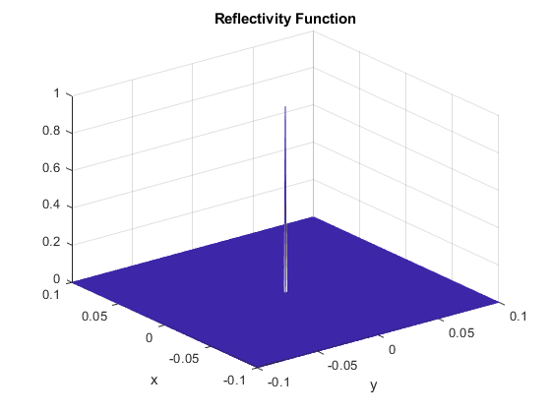
Initial Results – PSF Simulation
200mm x 200mm synthetic array
8 virtual channels in vertical axis
Virtual channels allow for fewer scans

Slide 41
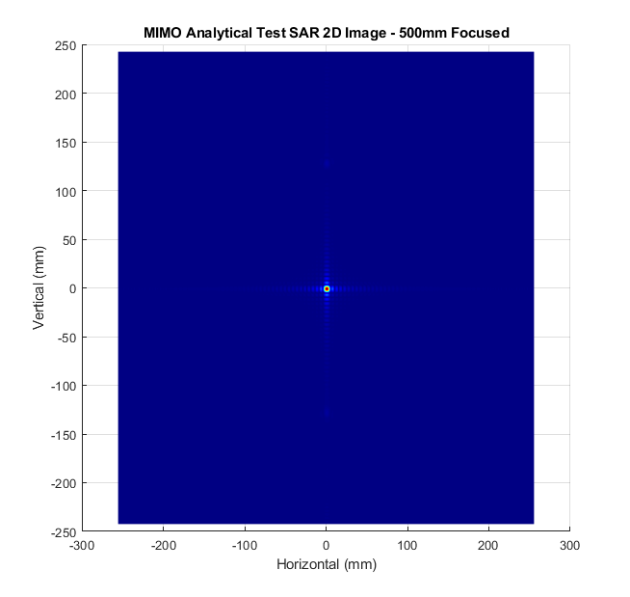
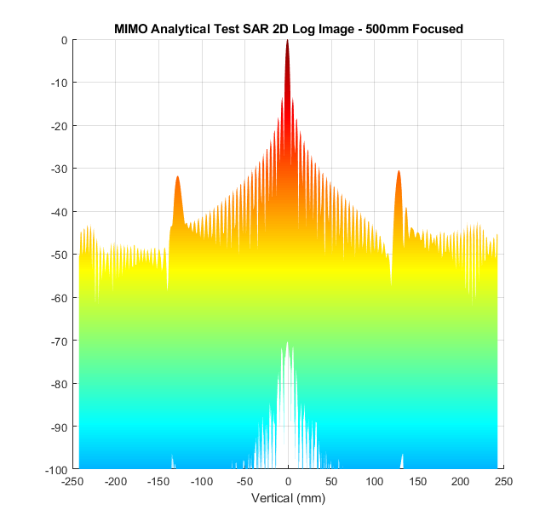
Initial Results – Without Phase Correction

Slide 42

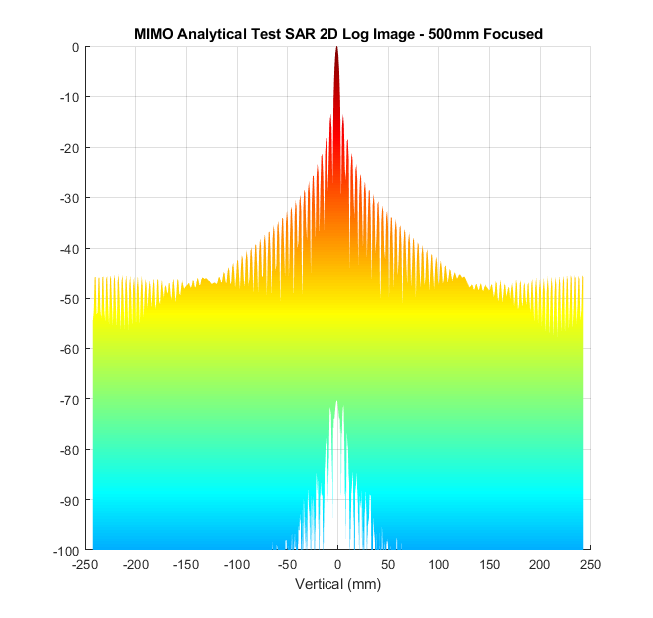
Initial Results – With Phase Correction

Slide 43
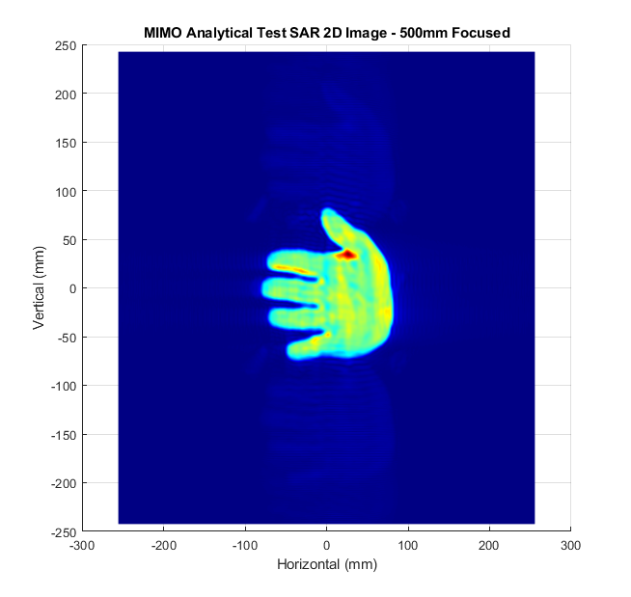

Hand Simulation

Slide 44
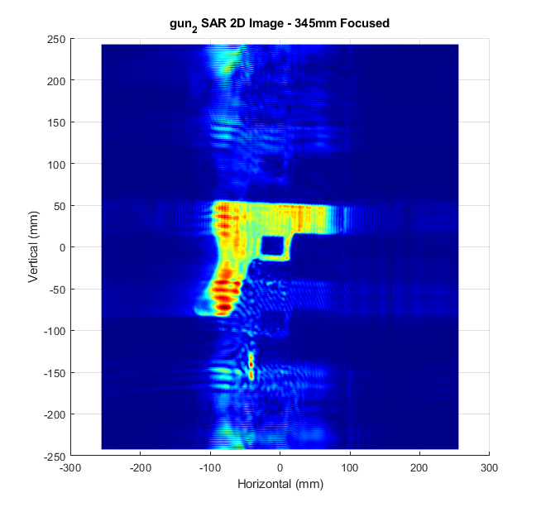
Gun Scan – Without Thresholding

Slide 45
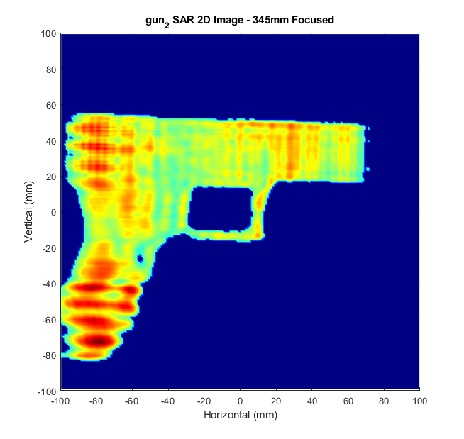
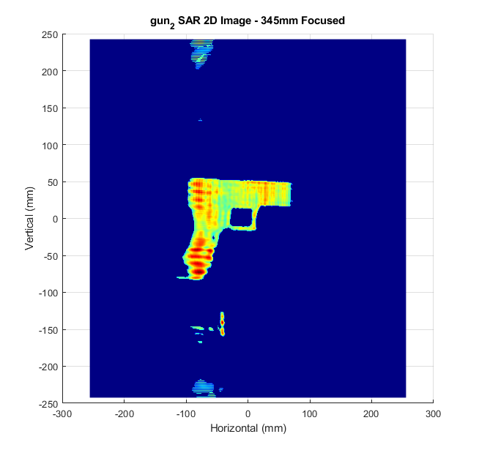
Gun Scan – With Thresholding

Slide 46
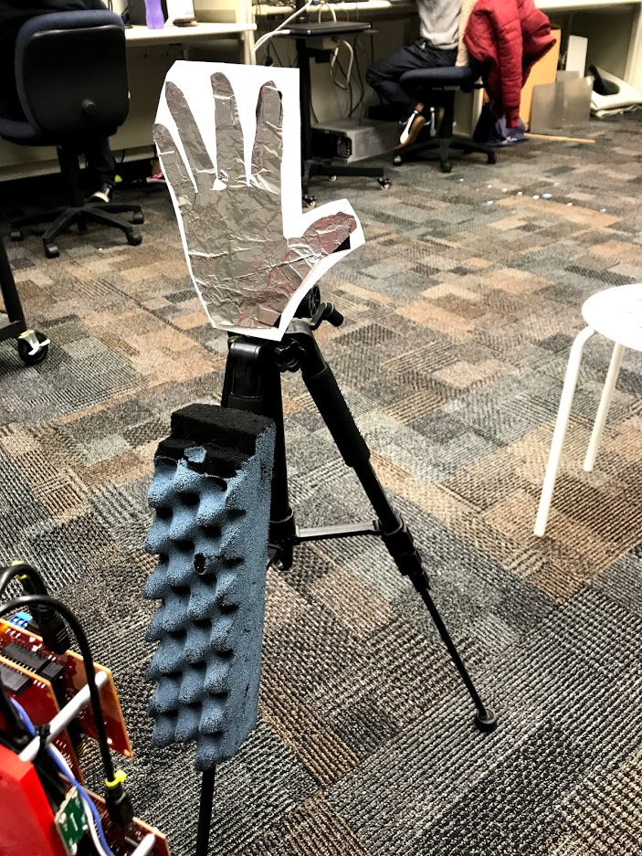
Foil Hand Scan

Slide 47
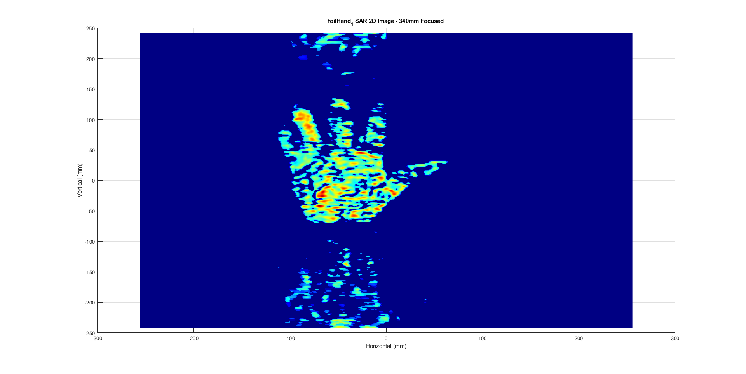
Foil Hand Scan

Slide 48
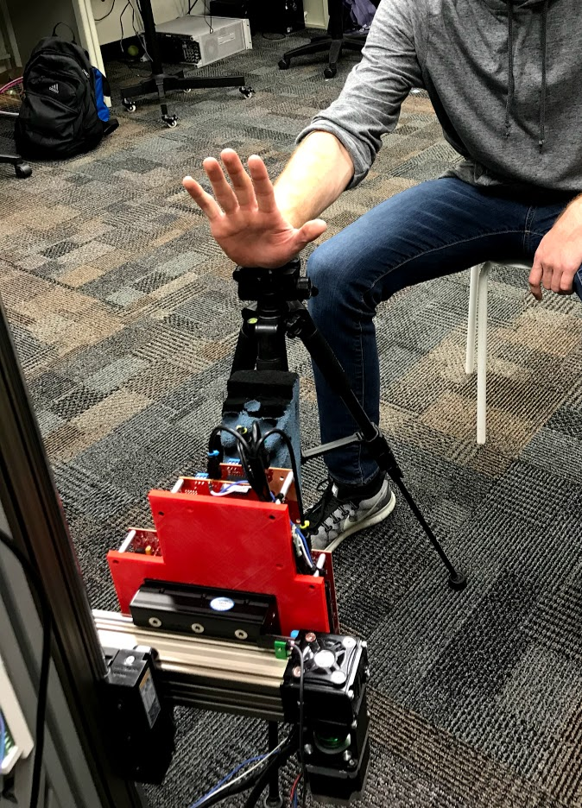
Human Hand Scan

Slide 49
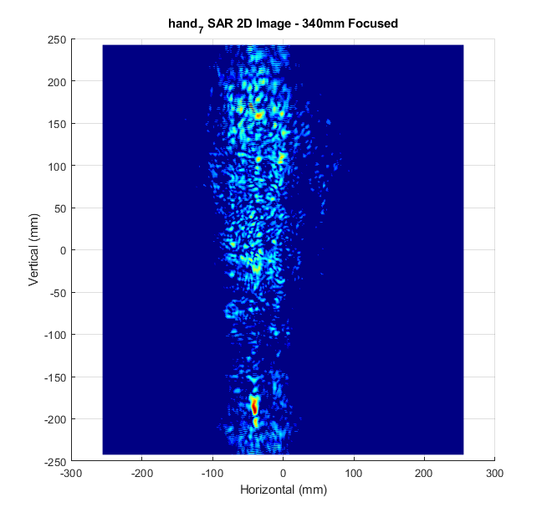
Human Hand Scan – With Thresholding
Bare hand has small RCS!!
Low SNR explains difficulty in accurately classifying static gestures

Slide 50
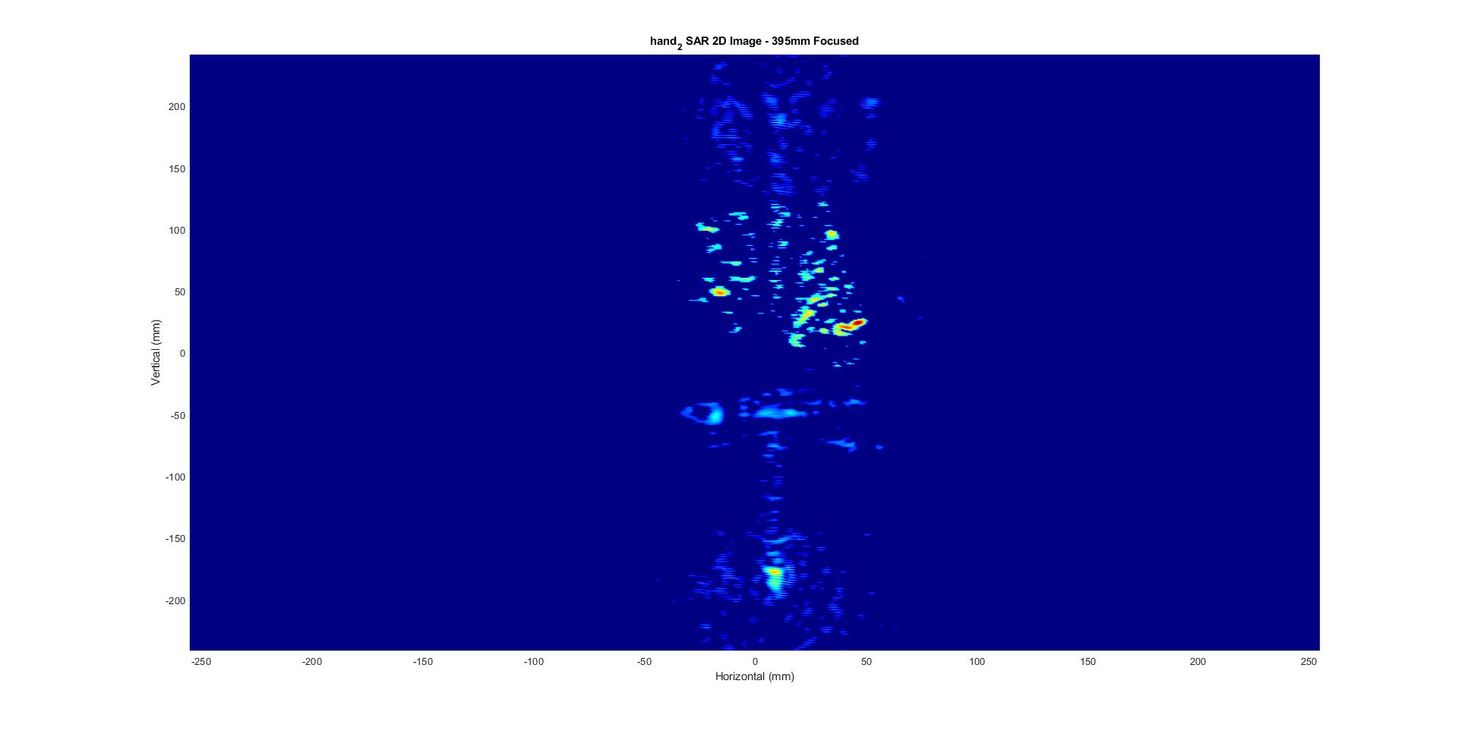
Human Hand Scan BEST – With Thresholding

Slide 51
Static Experiment
Can we train our model on sterile data (foil hand) and accurately classify human hand data?
6 static classes
Training: 5 human hand classes, 1 foil hand (palm) class
Results:
Control (all human data): 67.8% accuracy classifying human palms
Result (foil palm): 99% accuracy classifying human palms
Hypothesis: train with “sterile” data for improved performance and accentuated differences between classes

Slide 52
Interfacing with Terahertz Sensor IC

Slide 53
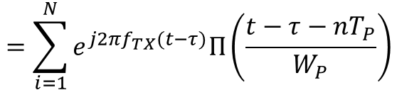

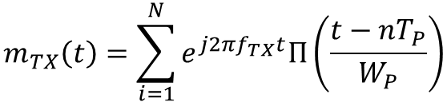
Motion Detection via Phase Extraction
USRP
Software
273.6GHz
480MHz
250kHz
50kHz
RF-TX
RF-RX
IF
D-IF
MD-IF
LPF
100kHz
479.75GHz
200kHz
Signal Generator
Signal Generator
Phase
Phase Extractor
Signal generators modulate carrier with pulse train
$$m_{TX}\left(t\right)=\sum_{i=1}^{N}{e^{j2πf_{TX}t}Π\left(\frac{t−nT_{P}}{W_{P}}\right)}$$
$$m_{RX}\left(t\right)=m_{TX}(t−τ)$$
$$=\sum_{i=1}^{N}{e^{j2πf_{TX}(t−τ)}Π\left(\frac{t−τ−nT_{P}}{W_{P}}\right)}$$

Slide 54
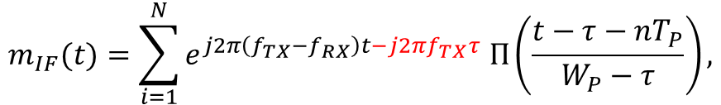
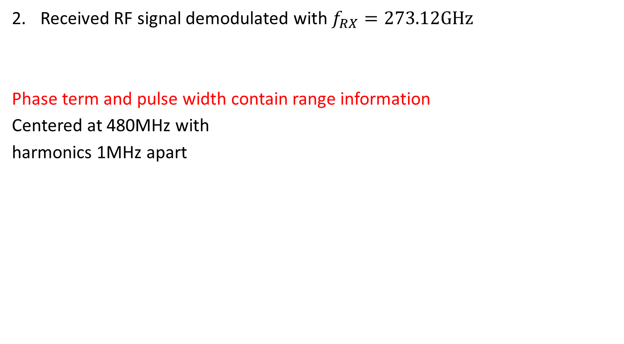

Motion Detection via Phase Extraction
Received RF signal demodulated with $f_{RX}=273.12GHz$
Phase term and pulse width contain range information
Centered at 480MHz with
harmonics 1MHz apart
$$m_{IF}(t)=\sum_{i=1}^{N}{e^{j2π\left(f_{TX}−f_{RX}\right)t−j2πf_{TX}τ} Π\left(\frac{t−τ−nT_{P}}{W_{P}−τ}\right),}$$
$$τ=\frac{R}{c}$$

Slide 55
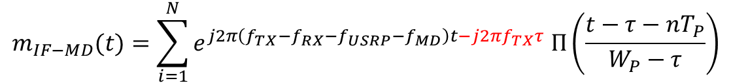
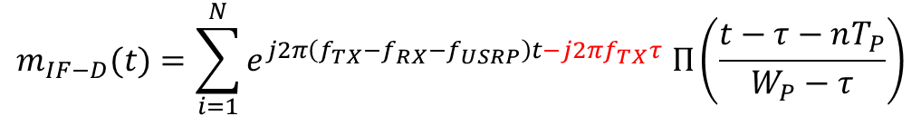


Motion Detection via Phase Extraction
USRP I-Q Demodulation: D-IF
Software Demodulation in MATLAB: MD-IF
Phase Extraction and Range Estimation
$$m_{IF−D}(t)=\sum_{i=1}^{N}{e^{j2π\left(f_{TX}−f_{RX}−f_{USRP}\right)t−j2πf_{TX}τ} Π\left(\frac{t−τ−nT_{P}}{W_{P}−τ}\right)}$$
Single peak at 50kHz
$$m_{IF−MD}(t)=\sum_{i=1}^{N}{e^{j2π\left(f_{TX}−f_{RX}−f_{USRP}−f_{MD}\right)t−j2πf_{TX}τ} Π\left(\frac{t−τ−nT_{P}}{W_{P}−τ}\right)}$$
$$φ=−2πf_{TX}τ$$
$$\hat{R}=−\frac{φ}{2πf_{TX}}c$$

Slide 56
Relative Range Estimation
Moved radar 0.5mm radially from sensor
Uncalibrated
Observed phase difference:
$$φ=−2.554$$
Estimated range:
$$\hat{R}=0.4457mm$$
Calibrated
Observed phase difference:
$$φ=−2.8647$$
Estimated range:
$$\hat{R}=0.4999mm$$

Slide 57
New Applications: Conveyor Belt Scenarios using Scanner
Simple Hidden Item Detection
Hidden Item Counting
Medication Packaging
Future Applications

Slide 58

Scenario: Hidden Item Detection
Box moves along conveyor belt at constant speed
Radar gets multiple perspectives of the box as it moves
(25, 8, 200)
Simple Case:
Is there an item in the box?
Is the box empty?
Vertically Aligned Array (8 ch)
?

Slide 59
Mechanical Imaging Scanner
2D linear mechanical scanner
Vertically Aligned Array (8 ch)
?

Slide 60
Using the Scanner
To simulate the conveyor belt:
Box held stationary
Scan the radar 200mm at 100mm/s capturing every 1mm
Feed range FFT into CNN for two class detection
1000 samples/class
Results:
1mm sampling: 100%
10mm subsampling: 100%
25mm subsampling 100%
-> Visually obvious in the range FFT

Slide 61
Hidden Item Counting

Slide 62




Scenario: Hidden Item Counting
Box moves along conveyor belt at constant speed
Radar gets multiple perspectives of the box as it moves
Four Cases:
No Items
1 Metal Item
2 Metal Items (10cm apart)
3 Metal Items

Slide 63
Using the Scanner
To simulate the conveyor belt:
100 samples/class
Scan the radar 200mm at 100mm/s capturing every 1mm
Feed range FFT into CNN for four class detection
Results:
1mm sampling: 100%
10mm subsampling: 100%
25mm subsampling 100%
-> Still visually observable in the range FFT

Slide 64
Medication Packaging

Slide 65



Scenario: Medication Packing
Box moves along conveyor belt at constant speed
Radar gets multiple perspectives of the box as it moves
Insert always facing radar
Box contains:
Pills in bottle and insert
Pills in bottle and no insert

Slide 66
Using the Scanner
To simulate the conveyor belt:
600 samples/class (every 10 box is at different location)
Scan the radar 200mm at 100mm/s capturing every 1mm
Feed range FFT into CNN for four class detection
Results:
1mm sampling: 100%
10mm subsampling: 100%
25mm subsampling 99.7%
-> Very minor change in the range FFT (but detectable by CNN)

Slide 67
Future Applications

Slide 68

Automotive Scene Classification
Radar continuously capturing images from a moving vehicle
Estimate the range of targets in various environments
Target classification: human, stationary object, another vehicle (stationary or moving)
Initial Steps:
Capture dynamic motions with scanner
Classify human movements
Image Courtesy of TI

